Slide 1
CS 4530: Fundamentals of Software Engineering Module 2, Lesson 1 User Stories
Rob Simmons
Khoury College of Computer Sciences
Notes:
SAY: we’re gonna be doing user stories on the first day of class, and we’re going to be talking about user stories in your presentations on the last day of class

Slide 2
What are user stories?
…a tool to keep our designs focused on the goal of meeting needs of people
…formulaic statements of this form:
…a tool for keeping large collaborative teams on the same page
As a <role> I want <capability> so that I can <get some benefit>

Slide 3







Where do user stories fit in?
PEOPLE
PROCESSES
PROGRAMS
PLANNING
ORGANIZING
user stories
implementing
Notes:
User stories — and conditions of satisfaction — live at the “organizing” level of our chart, right at the heart of software engineering (and this class). They tie together the people and processes that plan what organizations do with the actual implementation work of software development.

Slide 4
Learning Goals for this Lesson
At the end of this lesson, you should be able to
Explain the structure of a user story
Identify and fix user stories that don’t have the correct structure
Define the relationship between conditions of satisfaction and user stories, and the difference between essential, desired, and extension conditions
Identify whether a given condition of satisfaction actually relates to a given user story
Propose new conditions of satisfaction for new user stories

Slide 5
Roles: “who”
Roles are positions or functions that people inhabit!
“As a web server…” is not a user story!
“As a human being…” is better, but that’s still not a role
“As a user…” is almost always a cop-out
The person is not you!
As a <role> I want <capability> so that I can <get some benefit>
Notes:
Questions: what are some of the roles you and I fill with respect to Northeastern’s registrar?
The person is not you: I know you’ve had teachers who have forgotten this in the context of education. College professors are notorious about forgetting this in the context of education; CS education Leigh Ann Delyser always threatened to make a t-shirt that said “I’m sorry, you’re not my target demographic” when computer science professors argued that how she wanted CS taught to novices didn’t meet the model of a CS student in the professor’s head (which was usually very much like them).
Also mention “promotion driven design” — the user story is not about building things because you want to or because it’s good for your career. Sometimes you build things because you want to or because it’s good for your career! But if engineering is about solving problems with technology, that’s not software engineering.

Slide 6
Capabilities: “what”
A capability is a specific benefit
Because we’re building software, this is usually a benefit we can provide by software, otherwise let’s not build software
A capability relates to a role
“As a teacher at northeastern, I want to be able to access a laser cutter so I can finish an art project” is not a good user story.
As a <role> I want <capability> so that I can <get some benefit>

Slide 7
Capabilities: “what”
A capability is not a product
“As a College Administrator, I want a web application that does <this> and <that> so that I can…” is not a user story!
This is easy to get wrong in practice! Sometimes you really want to build a tic-tac-toe game.
You’re supposed to ask “do I even need to build this?”
As a <role> I want <capability> so that I can <get some benefit>

Slide 8
Benefit: “why?”
Benefits are key for user stories actually focusing on what matters to the user.
If a specific feature doesn’t relate to the benefit…
…maybe that feature isn’t worth building.
…maybe that feature is part of a different user story. (Maybe we should prioritize that different user story instead?)
As a <role> I want <capability> so that I can <get some benefit>

Slide 9
Examples:
As a College Administrator, I want to keep track of students, the courses they have taken, and the grades they received in those courses, so that I can advise them on their studies.
As a driver, I want to be able to report potholes to the city so that the town can more quickly act to keep me safe.
As a pedestrian, I want to be able to report potholes to the city so that drivers stop dangerously swerving onto the sidewalk when I’m walking.
As a card game enthusiast, I want to be able to play blackjack online so that I can…
Notes:
DISCUSSION:
The different roles of “driver” and “pedestrian” might lead to very different designs! (Why? Well, a pedestrian will have a much easier time safely stopping and accessing a phone app.)
What are the different benefits someone might get in this user story? Making social connections versus making money versus distracting myself while I’m on the subway have very different implications!

Slide 10

Conditions of Satisfaction fill in details
Each condition of satisfaction
Describes a testable behavior, from the user's point of view
Must have a priority
Should be numbered within its user story
Notes:
Conditions of satisfaction are, effectively, test cases – or templates for test cases. These kinds of tests are sometimes called “acceptance tests” because they constitute the end-user accepting that your software does what they want.

Slide 11
Priorities
Essential (E) means the project is useless without it.
Desirable (D) means the project is less usable without it, but is still usable.
Extension (X) describes a user story or COS that is may not be achievable within the scope of the project. These might be things you'd want "in the next version".
Notes:
User stories and COSs must be prioritized as Essential, Desirable or Extension.

Slide 12
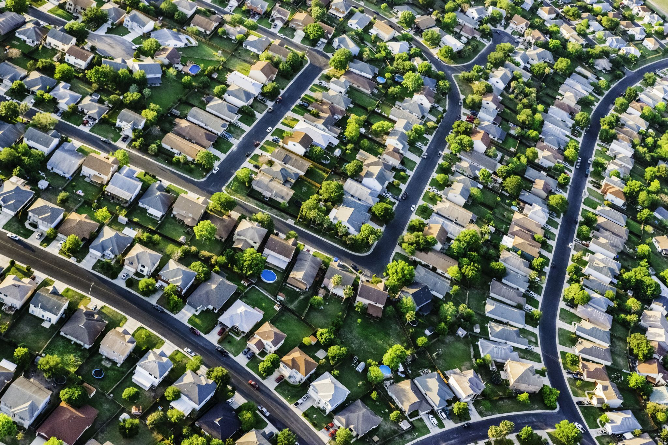
Worked Example: Pothole reporting system
A town is designing a system where citizens can a report potholes and the town can monitor progress on repairing them.

Slide 13
User Story #1
As a car commuter, I want to be able to report potholes to the city so that the town can more quickly act to keep me safe.

Slide 14
Conditions of Satisfaction
1.1 I should be able to report the location of a pothole to the system (E)
1.2 I should be able to see whether the pothole I report has been repaired (E)
1.3 I should be able to see whether others have reported potholes near me (D)
1.4 I should be able to see an estimated time when the pothole should be repaired (X)

Slide 15
User Story #2
As a pothole-repair-truck driver, I want the system to display the potholes I should be working on today. (E)

Slide 16
Conditions of Satisfaction
2.1 I should be able to see my list of potholes for today (E)
2.2 I should be able to report that I repaired a given pothole (E)
2.3 I should be able to report that I was unable to repair a given pothole, and to supply a reason (E)
2.4 My daily list of potholes should be listed in an order that cuts down the time I spend driving from job to job (D)

Slide 17
User Story #3
As a maintenance supervisor, I want to be able to control the order in which potholes are repaired (D?)
Notes:
Maybe this is desirable, maybe it's essential.

Slide 18
Conditions of Satisfaction
3.1 I should be able to give a higher priority to potholes on a particular street (E)
3.2 I should be able to give a higher priority potholes in a particular neighborhood (E)
3.3 I should be able to see on a map where there are a lot of potholes (D)
3.4 I should be able to see on a map which potholes that have been reported multiple times (D)

Slide 19
Review
It’s the end of this lesson, so you should be able to
Explain the structure of a user story
Identify and fix user stories that don’t have the correct structure
Define the relationship between conditions of satisfaction and user stories, and the difference between essential, desired, and extension conditions
Identify whether a given condition of satisfaction actually relates to a given user story
Propose new conditions of satisfaction for new user stories

